Slide 1
Power co, Expolatory data analysis

Slide 2


AGENDA
INTRODUCTION
PRIMARY GOALS
AREAS OF GROWTH
SUMMARY

Slide 3
PRIMARY GOALS
Testing whether there is a correlation between churning and sales price.

Slide 4
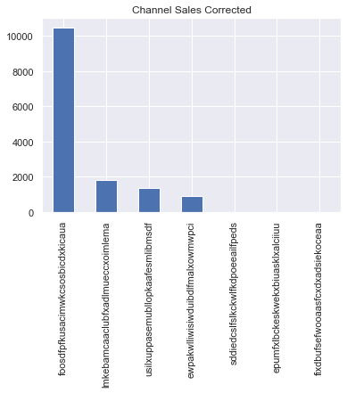
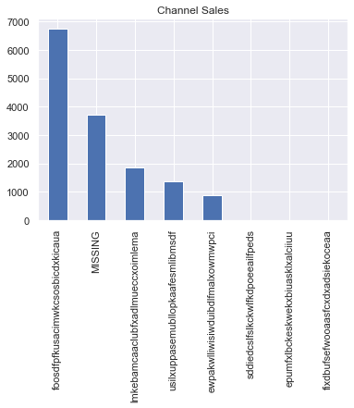
The “MISSING” values included in the ‘channel_sales’ column, creates a problem. Due to how much of the column data it constitutes, it is unadvisable to delete all its values. An attempt at imputation creates a bias by transforming ‘foosdfpfkusacimwkcsosbicdxkicaua’ into the highest value without proof. The safe alternative was to proceed with the data with “MISSING” included.

Slide 5
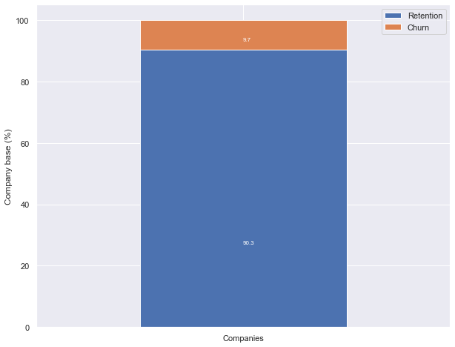
10% of customers have churned

Slide 6
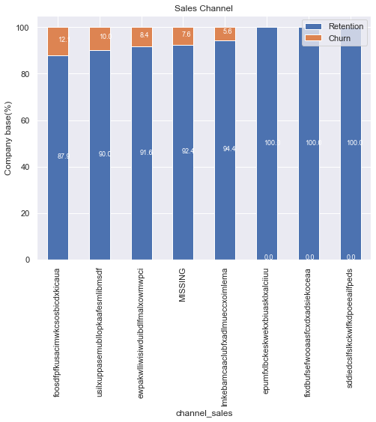
‘foosdfpfkusacimwkcsosbicdxkicaua’ has the highest churn rate, however, this is because it has the highest sales

Slide 7
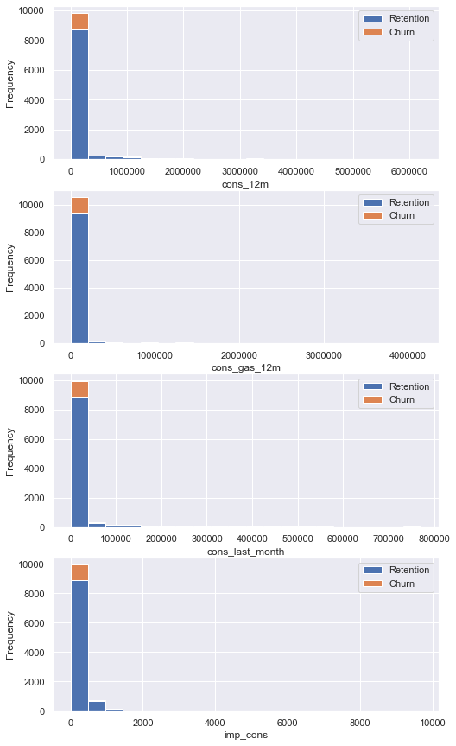
All of the distributions here are right skewed. Therefore, this could indicate that a small number of customers are responsible for a large portion of gas and electricity consumption.

Slide 8
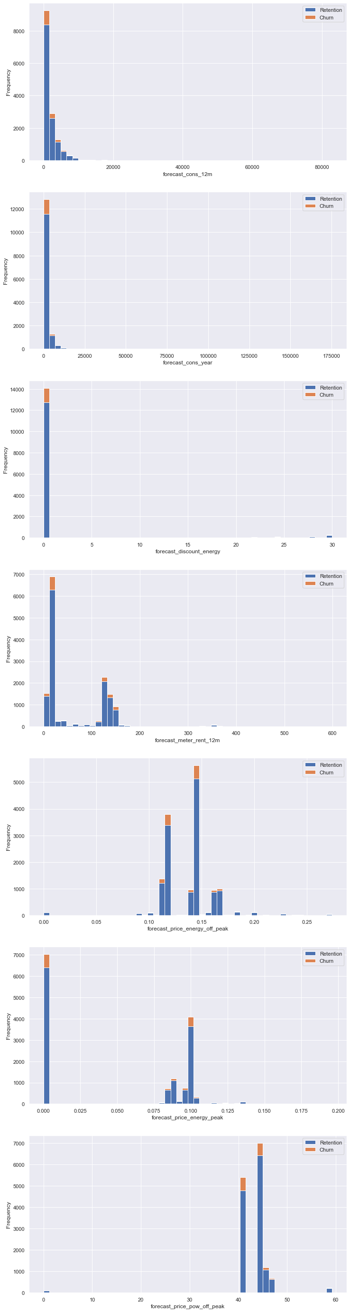
Here also, most of the distributions here are right skewed. Therefore, this could indicate that a small number of customers are responsible for a large portion of sales revenue. This could suggest that a business should focus their marketing efforts and resources on these high-value customers in order to maximize profits.

Slide 9
Here also, most of the distributions here are right skewed. Therefore, this could indicate that a small number of customers are responsible for a large portion of sales revenue. This could suggest that a business should focus their marketing efforts and resources on these high-value customers in order to maximize profits.

Slide 10
THANK YOU

